Slide 1

Ministry/Organization Name : Ministry of Defence, Defence Research and Development Organisation. PS Code : NR1164 Problem Statement Title : Device an E-waste management system technologically efficient and eco friendly. Team Name : TECH REBEL Team Leader Name : Yash Pragnesh Desai Institute Code : C-185 Institute Name : Chhotubhai Gopalbhai Patel Institute of Technology (C.G.P.I.T) Theme Name : Smart Automation
SMART INDIA HACKATHON 2022

Slide 2
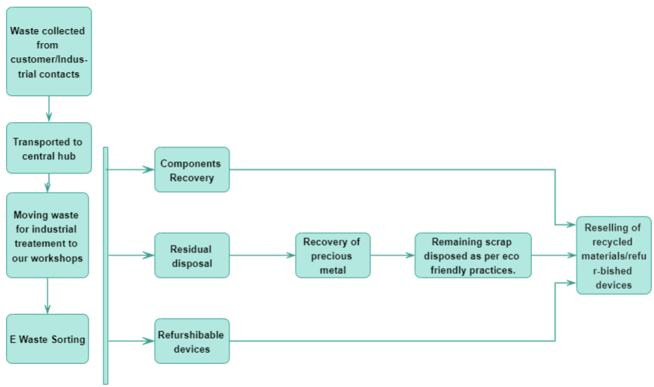

SOLUTION:
We have developed an industrial model for proper management and disposal of
E-WASTE.
It can be achieved by following steps :
Collecting E-WASTE: collection of e waste through industrial contact and web portal.
Training of employees: We will conduct training session in which the employees will be familiarized on how to manage the collected E –WASTE.
Industrial Treatment: Proper segregation, recycling, reclamation and disposal of E-WASTE.
Reselling: We will sell the recycled materials back in the market through various channels to generate our income.
Technology Stack:-

Slide 3
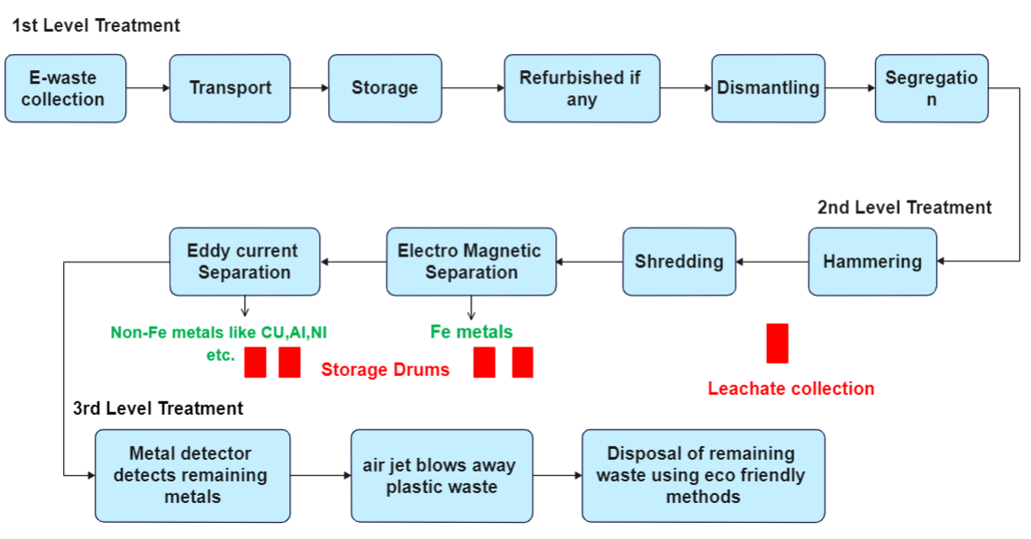
Industrial Treatment
Manual Seperation:-Glass, reusable components and devices and precious metals are collected from the heap of E-WASTE.
Shredder:-This will shred the e-waste into small chunks of metal and plastics and with the help of a conveyor belt we will transfer this pieces to over-head magnet for electro magnetic separation.
Electro Magnetic Separation:-With the help of a strong magnet we will separate iron and steel from the waste stream and recycle them.
EDS:-Eddy Current Separator is used to separate non ferrous metals like copper, aluminium and circuit boards now only plastic waste remains on the conveyor belt.
Metal-Detector:-Metal Detector detects the residual metals so that we can obtain pure plastic stream at the end.
Air-jet:-It blows away the plastic waste directly into containers so that they can be recycled while the remanant metals get discarded in the end.

Slide 4
Team Member Details
Team Leader Name: YASH P DESAI
Branch :B.TECH Stream :INFORMATION TECHNOLOGY Year : 3rd Year
Team Member 1 Name: PRINCE D PATEL
Branch :B.TECH Stream : INFORMATION TECHNOLOGY Year : 3rd Year
Team Member 2 Name: URSH K PATEL
Branch :B.TECH Stream : INFORMATION TECHNOLOGY Year : 3rd Year
Team Member 3 Name: SANJANA TANDEL
Branch :B.TECH Stream : INFORMATION TECHNOLOGY Year : 3rd Year
Team Member 4 Name: SIRVI CHANDA
Branch :B.TECH Stream : INFORMATION TECHNOLOGY Year : 3rd Year
Team Member 5 Name: JANVI MAKANI
Branch :B.TECH Stream : INFORMATION TECHNOLOGY Year : 3rd Year
Team Mentor 1 Name: HELLY MEHTA
Category : Academic Expertise: Environmental Engineering Domain Experience: 7 Years
Team Mentor 2 Name: JITISHA PATEL
Category : Academic Expertise : Computer Networking Domain Experience: 6 Years

